Slide 1
Exploratory Analysis and Unsupervised Learning
Introduction to Machine Learning with Python
SIB Swiss Institute of Bioinformatics, Lausanne
7 - 8 June 2021

Slide 2
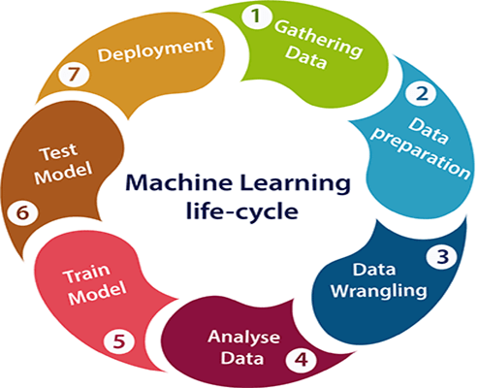
Pairplots
Select fatures
PCA, ICA, t-SNE,UMAP
K-means,
Hclust, DBSCAN
Variance stabilization
Missing value Imputation
https://www.javatpoint.com/machine-learning-life-cycle

Slide 3
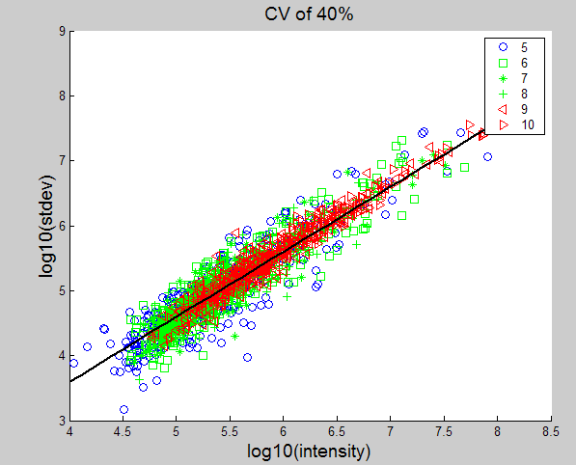
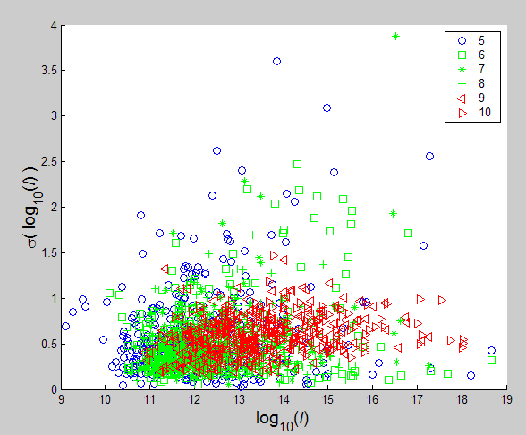
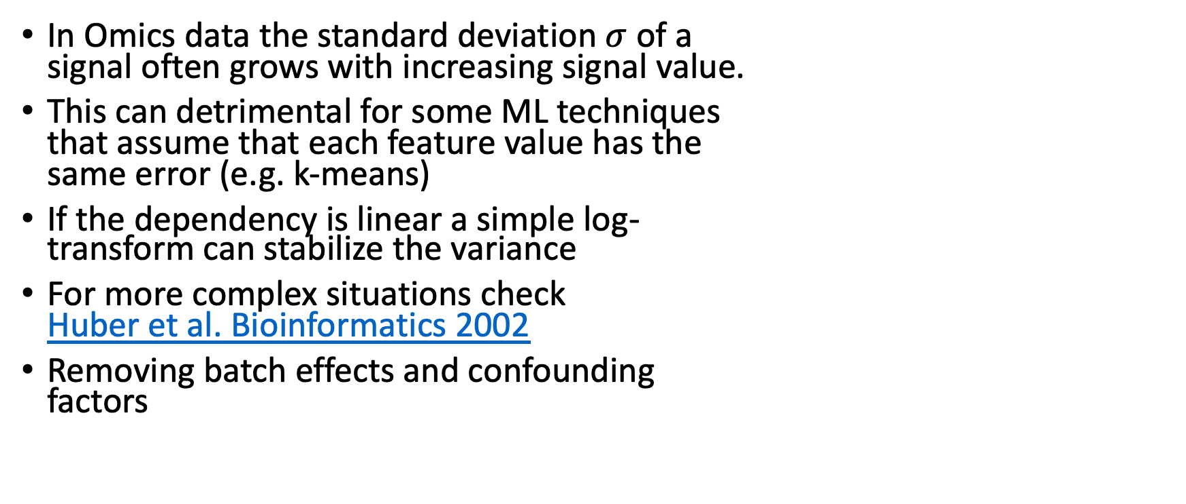
Variance Stabilization
In Omics data the standard deviation $σ$of a signal often grows with increasing signal value.
This can detrimental for some ML techniques that assume that each feature value has the same error (e.g. k-means)
If the dependency is linear a simple log- transform can stabilize the variance
For more complex situations check Huber et al. Bioinformatics 2002
Removing batch effects and confounding factors

Slide 4
Missing Values (MV)
Omics data (especially proteomics) often have missing values, which can be caused by leaky measurement or data processing
There are two main strategies to deal with MVs: discard or impute them
MVs can occur at random or depend on feature values
For missing at random we can only replace or impute them by the best guess, the global non-missing mean (Donders et al, J. Clin. Epi., 2006)
In the latter case, we can try to predict the MVs using the feature values using e.g. EM, KNN, SVD, Regression (Troyanskaya et al, Bioinformatics, 2001)

Slide 5
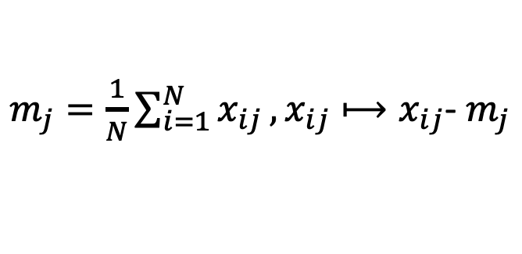
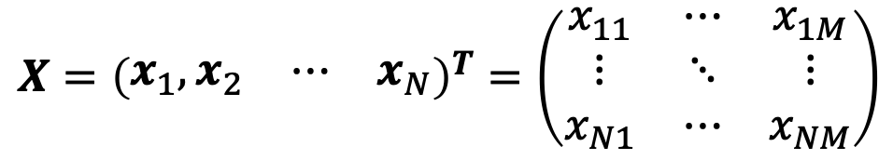
Some Notations:
M features
$$X={\left(\begin{matrix}x_{1},x_{2} & ⋯ & x_{N}\end{matrix}\right)}^{T}=\left(\begin{matrix}x_{11} & ⋯ & x_{1M} \\ ⋮ & ⋱ & ⋮ \\ x_{N1} & ⋯ & x_{NM}\end{matrix}\right)$$
Data matrix:
N measurements
Zero centering:
$m_{j}=\frac{1}{N}\sum_{i=1}^{N}{x_{ij}},x_{ij}⟼x_{ij}$- $m_{j}$
Columns have 0 means

Slide 6
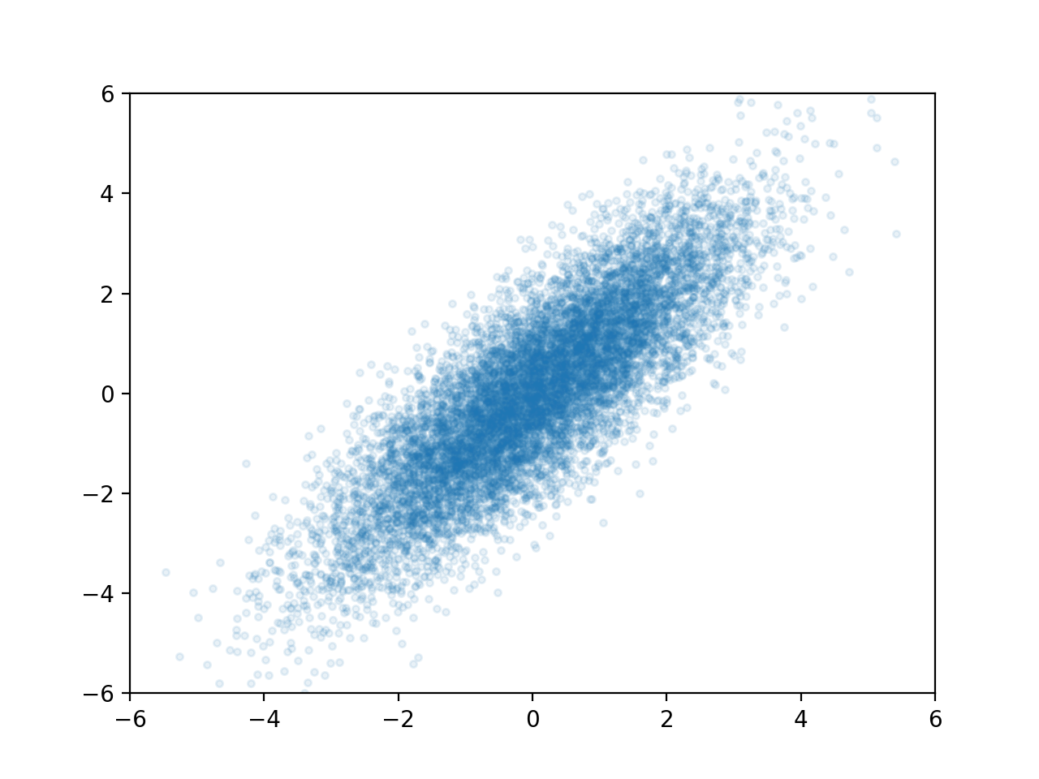
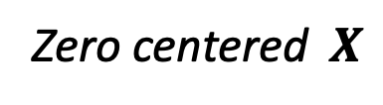

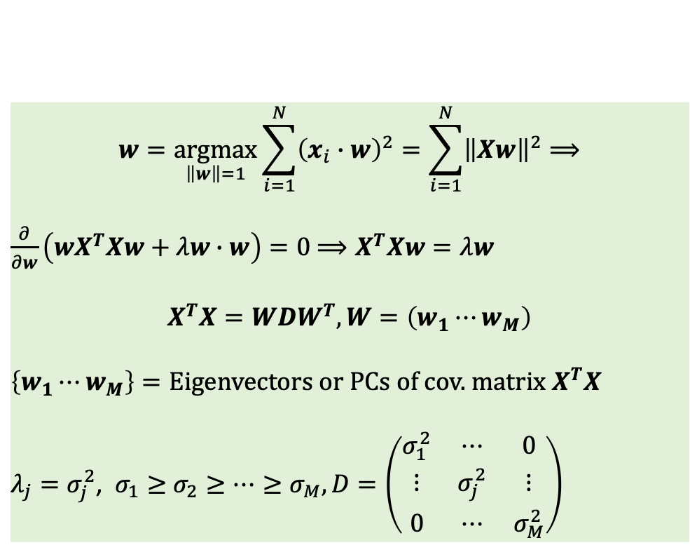

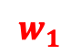
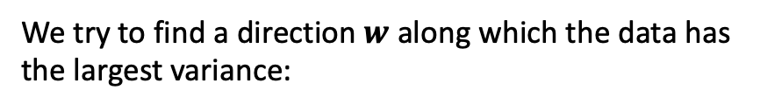
Principal Component Analysis (PCA)
We try to find a direction $w$ along which the data has
the largest variance:
Zero centered$X$
$$w=\underset{\left\|w\right\|=1}{argmax}{\sum_{i=1}^{N}{{\left(x_{i}∙w\right)}^{2}}}=\sum_{i=1}^{N}{{\left\|Xw\right\|}^{2}⟹}$$
$\frac{∂}{∂w}\left(wX^{T}Xw+λw∙w\right)=0$ $⟹X^{T}Xw=λw$
$$X^{T}X=WDW^{T},W=\left(w_{1}⋯w_{M}\right)$$
$\left\{w_{1}⋯w_{M}\right\}=\text{Eigenv}\text{ectors} \text{or} \text{PCs} \text{of} \text{cov}\text{.} \text{matrix}$ $X^{T}X$
$λ_{j}=σ_{j}^{2}$, $σ_{1}≥$ $σ_{2}≥⋯≥σ_{M}, D=\left(\begin{matrix}σ_{1}^{2} & ⋯ & 0 \\ ⋮ & σ_{j}^{2} & ⋮ \\ 0 & ⋯ & σ_{M}^{2}\end{matrix}\right)$
$$w_{2}$$
$$w$$
$$w_{1}$$

Slide 7
Principal Component Analysis (PCA)
Dimension reduction and visualization
Decorrelate or whiten signals
Data compression

Slide 8
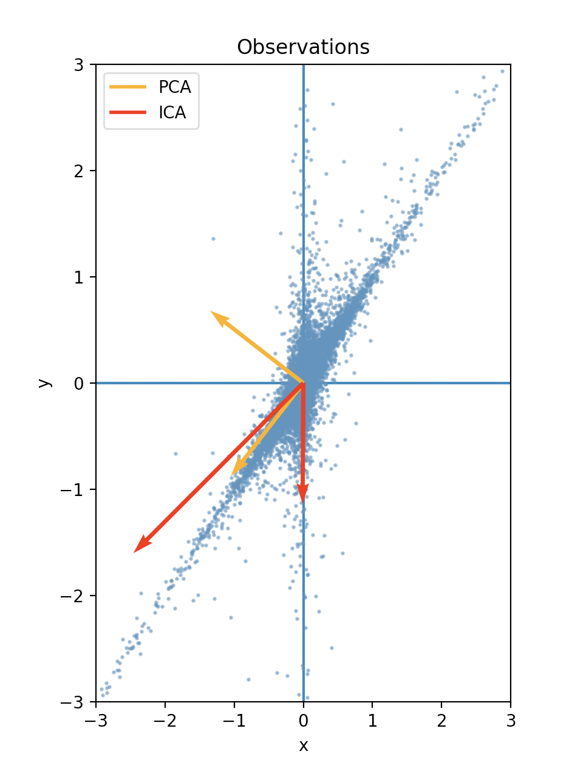
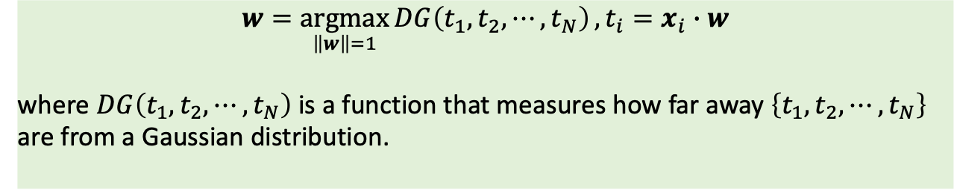
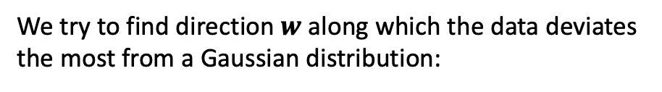
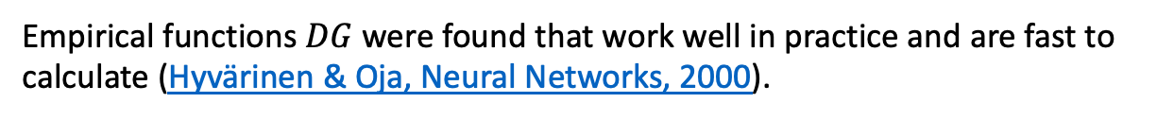
Independent Component Analysis (ICA)
We try to find direction $w$ along which the data deviates
the most from a Gaussian distribution:
$$w=\underset{\left\|w\right\|=1}{argmax}{DG\left(t_{1},t_{2},⋯,t_{N}\right)},t_{i}=x_{i}∙w$$
where $DG\left(t_{1},t_{2},⋯,t_{N}\right)$ is a function that measures how far away $\left\{t_{1},t_{2},⋯,t_{N}\right\}$ are from a Gaussian distribution.
Empirical functions $DG$ were found that work well in practice and are fast to calculate (Hyvärinen & Oja, Neural Networks, 2000).

Slide 9
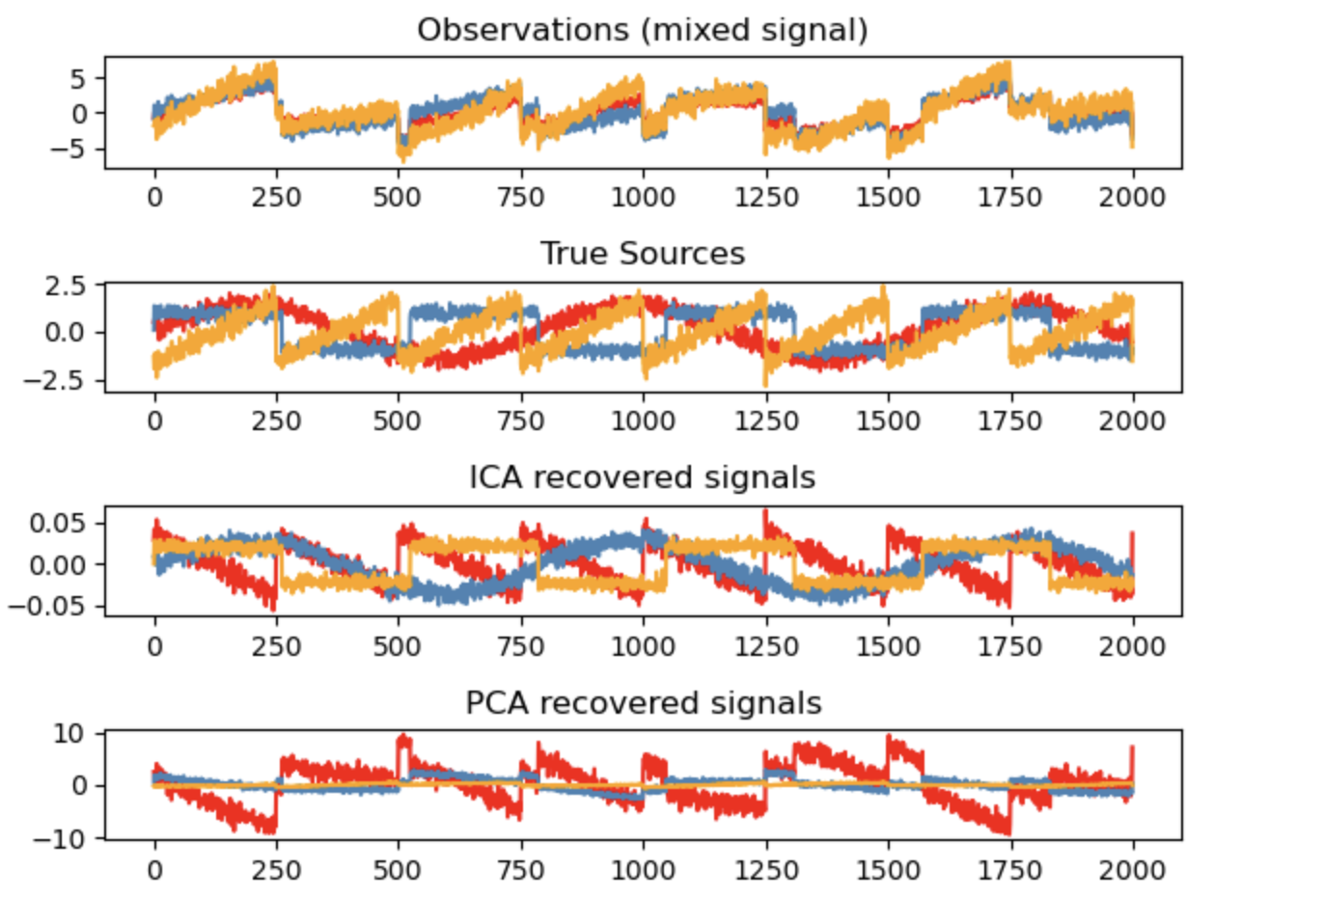
Independent Component Analysis (ICA)

Slide 10
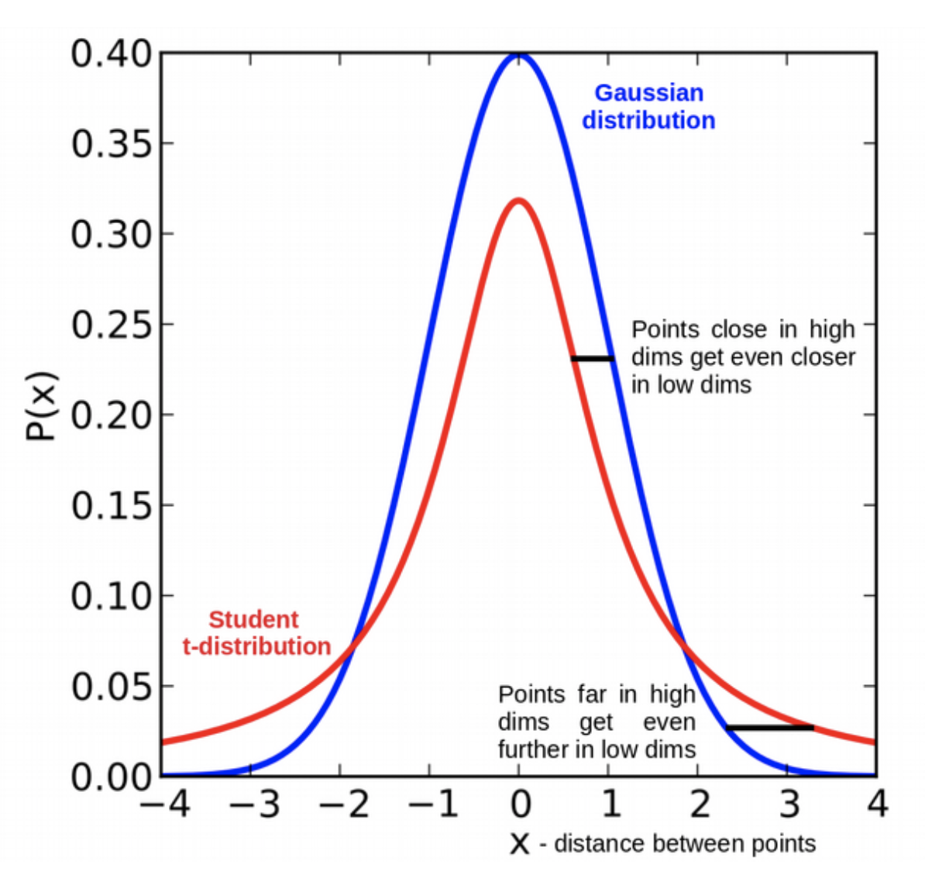
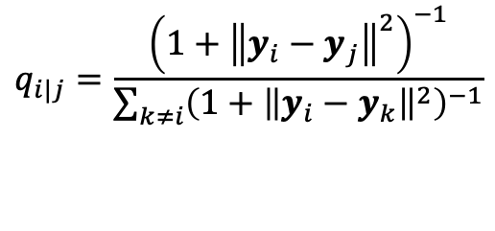
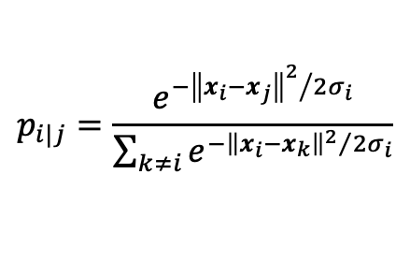
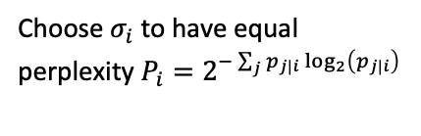
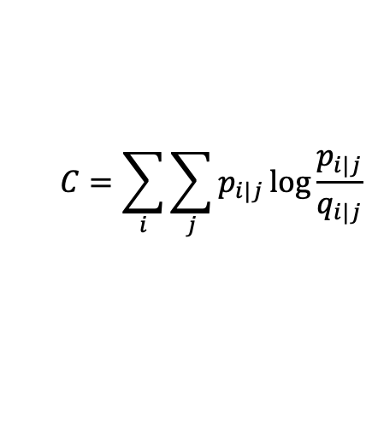
t-distributed Stochastic Neighborhood Embedding (t-SNE)
Choose $σ_{i}$ to have equal
perplexity $P_{i}=2^{−\sum_{j}{p_{j|i}}\log_{2}\left(p_{j|i}\right)}$
$$p_{i|j}=\frac{e^{{−{\left\|x_{i}−x_{j}\right\|}^{2}}/{2σ_{i}}}}{\sum_{k≠i}{e^{{−{\left\|x_{i}−x_{k}\right\|}^{2}}/{2σ_{i}}}}}$$
$$q_{i|j}=\frac{{\left(1+{\left\|y_{i}−y_{j}\right\|}^{2}\right)}^{−1}}{\sum_{k≠i}{{\left(1+{\left\|y_{i}−y_{k}\right\|}^{2}\right)}^{−1}}}$$
t-SNE
optimize
$$C=\sum_{i}{\sum_{j}{p_{i|j}}\log{\frac{p_{i|j}}{q_{i|j}}}}$$
Maaten & Hinton, JMLR, 2008

Slide 11
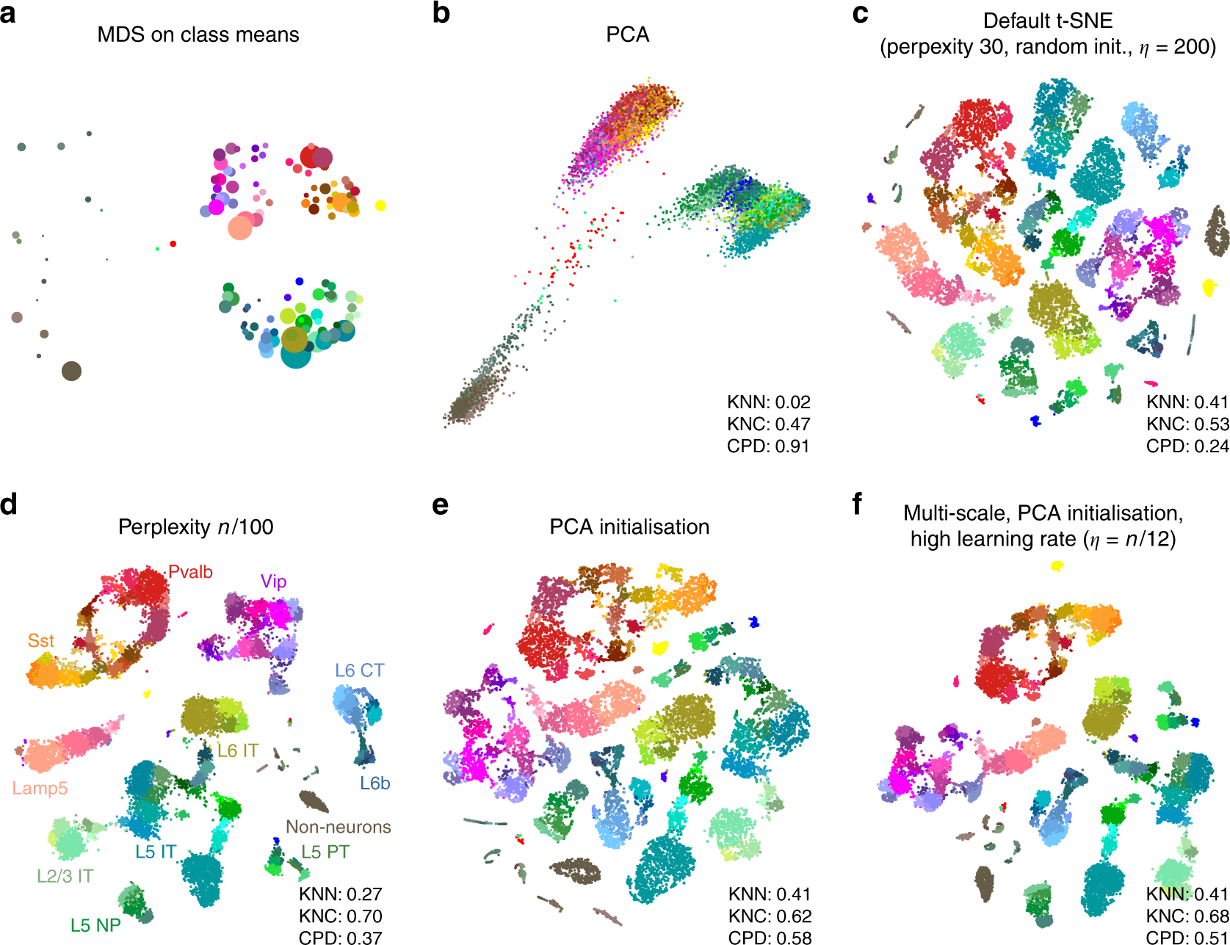
t-distributed Stochastic Neighborhood Embedding (t-SNE)
Single cell analysis
Kobab & Berens, Nature Comm., 2019

Slide 12
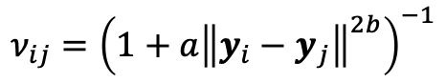
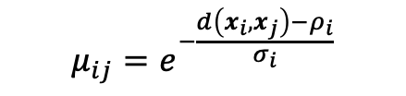
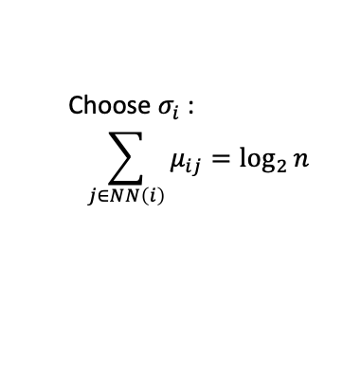
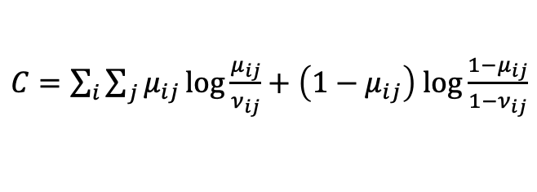
Uniform manifold approximation and projection (UMAP)
Choose $σ_{i}$ :
$$\sum_{j∈NN\left(i\right)}{μ_{ij}}=\log_{2}{n}$$
$$μ_{ij}=e^{−\frac{d\left(x_{i},x_{j}\right)−ρ_{i}}{σ_{i}}}$$
$$ν_{ij}={\left(1+a{\left\|y_{i}−y_{j}\right\|}^{2b}\right)}^{−1}$$
UMAP
Initialize with SpecClust
& optimize
$C=\sum_{i}{\sum_{j}{μ_{ij}}\log{\frac{μ_{ij}}{ν_{ij}}}}+\left(1−μ_{ij}\right)$ $\log{\frac{{1−μ}_{ij}}{1−ν_{ij}}}$
McInnes et al.,arxiv, 2018

Slide 13
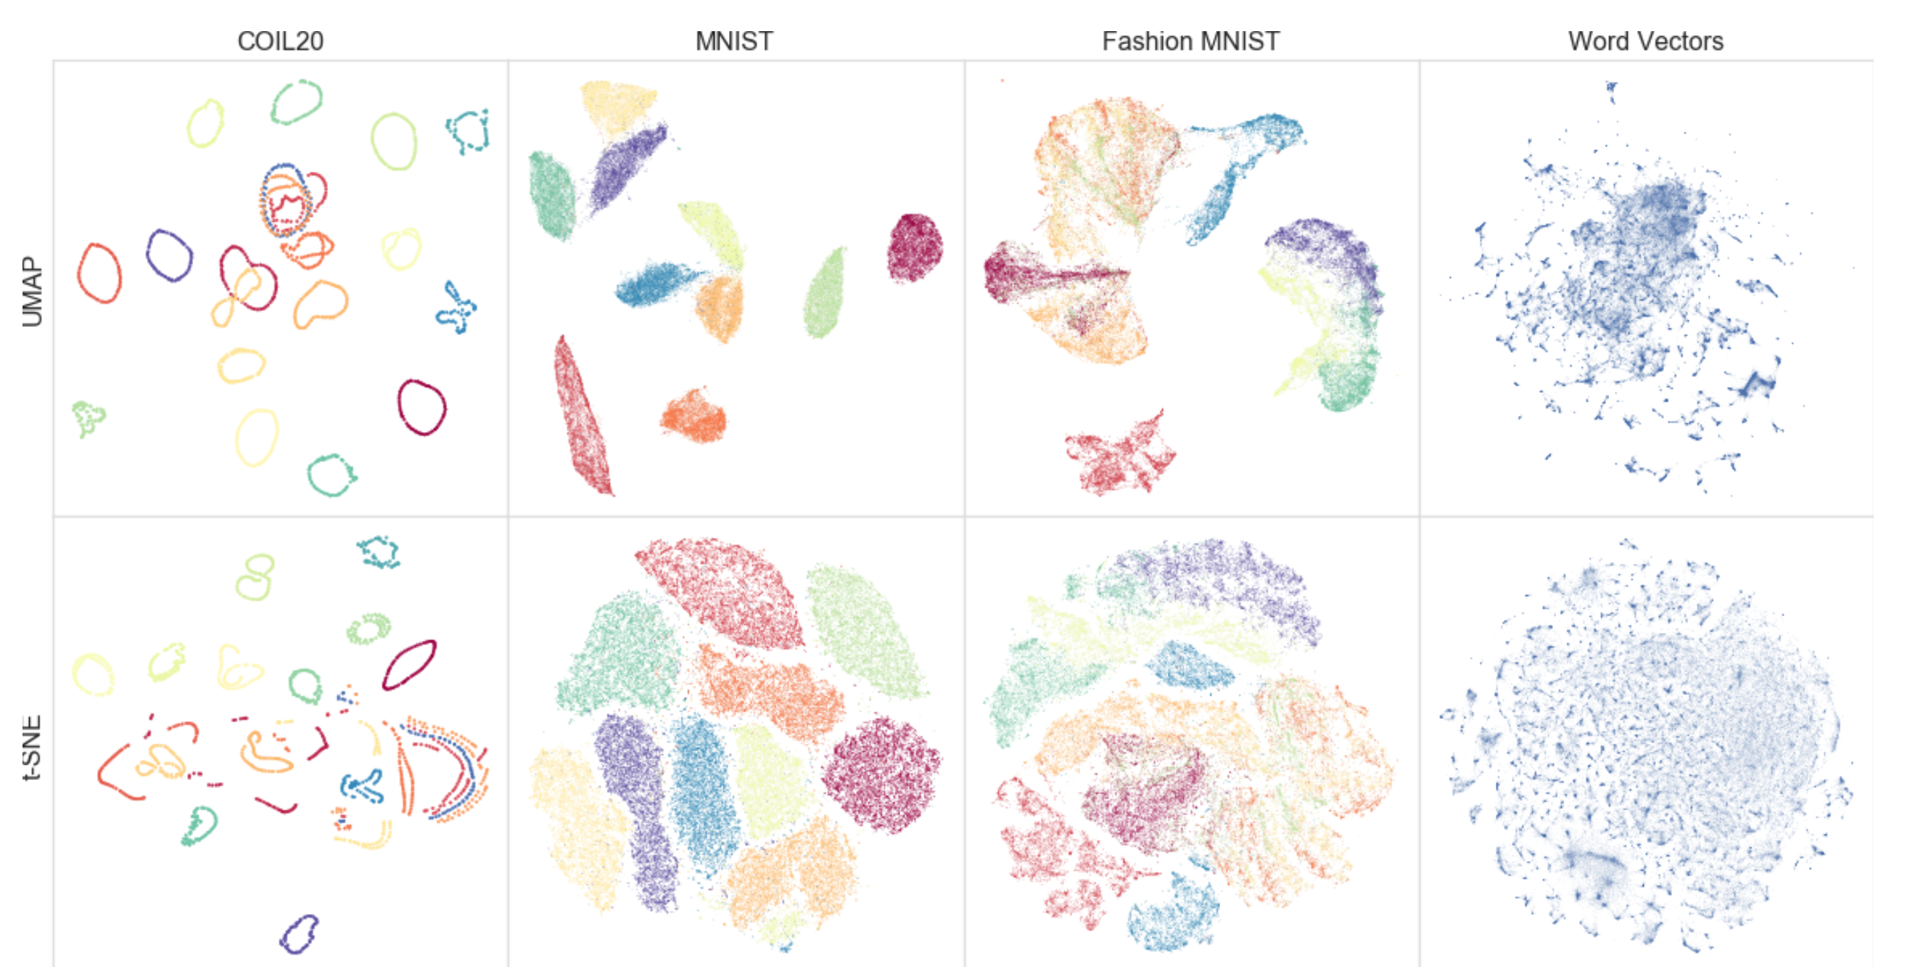
T-SNE versus UMAP
McInnes et al., 2018
Nikolay Oskolkov’s blog

Slide 14
Clustering
Pattern detection: discover hidden patterns in your data
Compression: replace all cluster members by one representative
Data augmentation: replace noisy feature vectors by the cluster consensus vector
Dimensionality reduction: replace a feature vector by cluster similarities
Outlier detection: detect feature vectors far away from cluster centers
Semisupervised learning: assign cluster labels to unlabeled cluster members

Slide 15
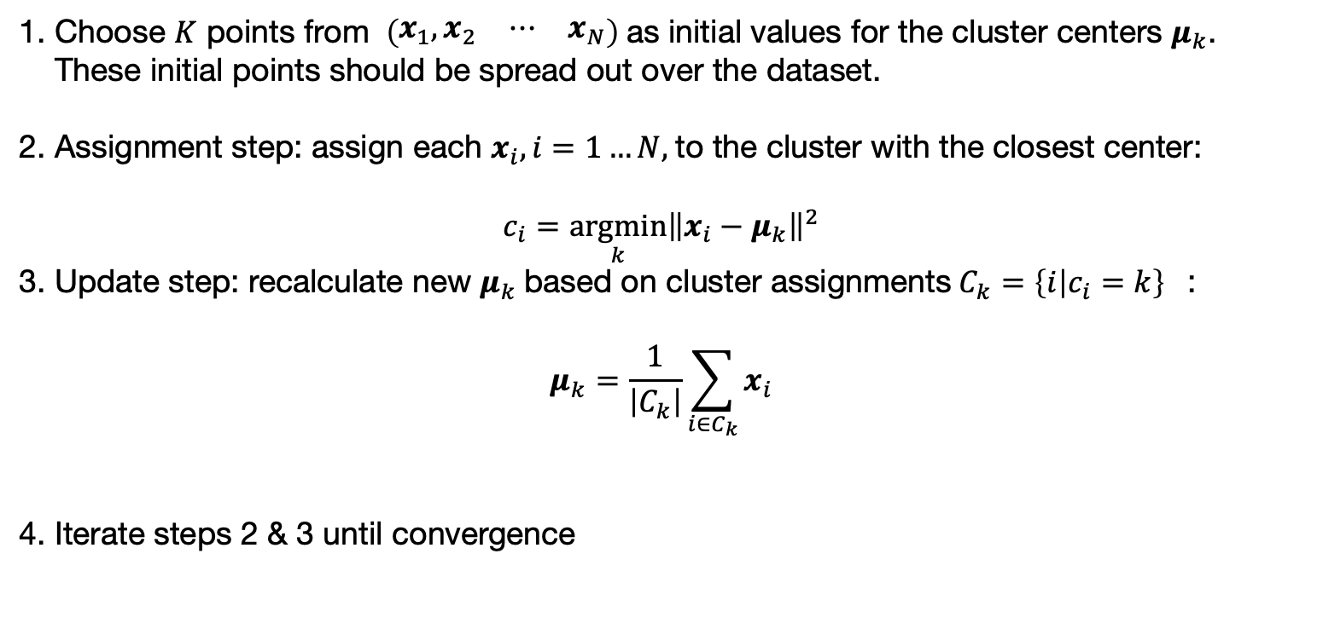
K-means Clustering
Choose $K$ points from $\left(\begin{matrix}x_{1},x_{2} & ⋯ & x_{N}\end{matrix}\right)$as initial values for the cluster centers $μ_{k}$. These initial points should be spread out over the dataset.
Assignment step: assign each $x_{i}, i=1…N,$to the cluster with the closest center: $c_{i}=\underset{k}{argmin}{{\left\|x_{i}−μ_{k}\right\|}^{2}}$
Update step: recalculate new $μ_{k}$based on cluster assignments ${C_{k}=\left\{i | c_{i}=k\right\}}_{}$: $μ_{k}=\frac{1}{\left|C_{k}\right|}\sum_{i∈C_{k}}{x_{i}}$
Iterate steps 2 & 3 until convergence
K-means at work

Slide 16
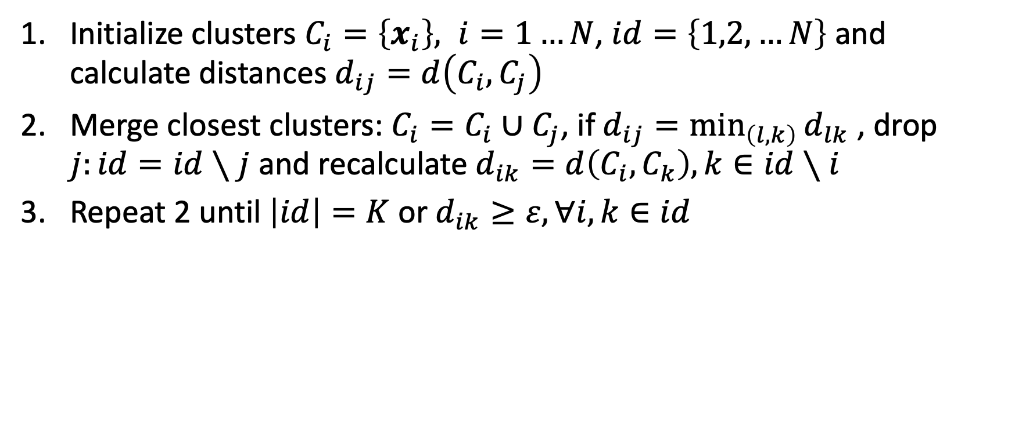
Agglomerative Hierarchical Clustering
Initialize clusters $C_{i}=\left\{x_{i}\right\}, i=1…N$, $id=\left\{1,2,…N\right\}$ and calculate distances $d_{ij}=d\left(C_{i},C_{j}\right)$
Merge closest clusters: $C_{i}=C_{i}∪$ $C_{j}$, if $d_{ij}=\min_{\left(l,k\right)}{d_{lk}}$ , drop $j:id=id∖j$ and recalculate $d_{ik}=d\left(C_{i},C_{k}\right), k∈id∖i$
Repeat 2 until $\left|id\right|=K$ or $d_{ik}≥ε, ∀i,k∈id$

Slide 17
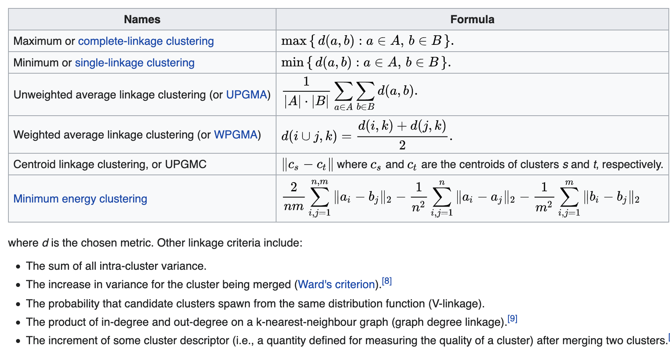
Agglomerative Hierarchical Clustering
https://en.wikipedia.org/wiki/Hierarchical_clustering

Slide 18
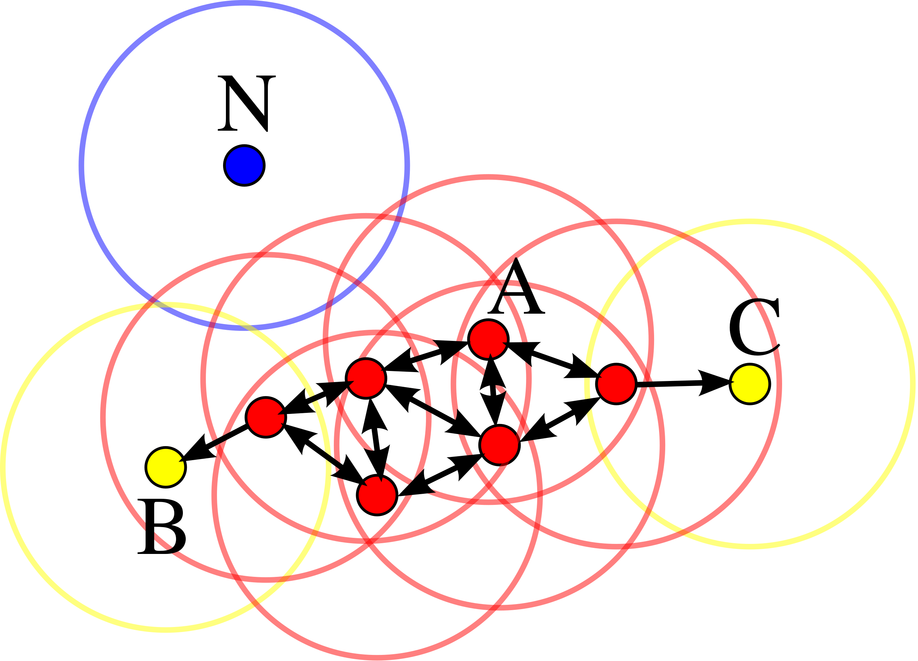
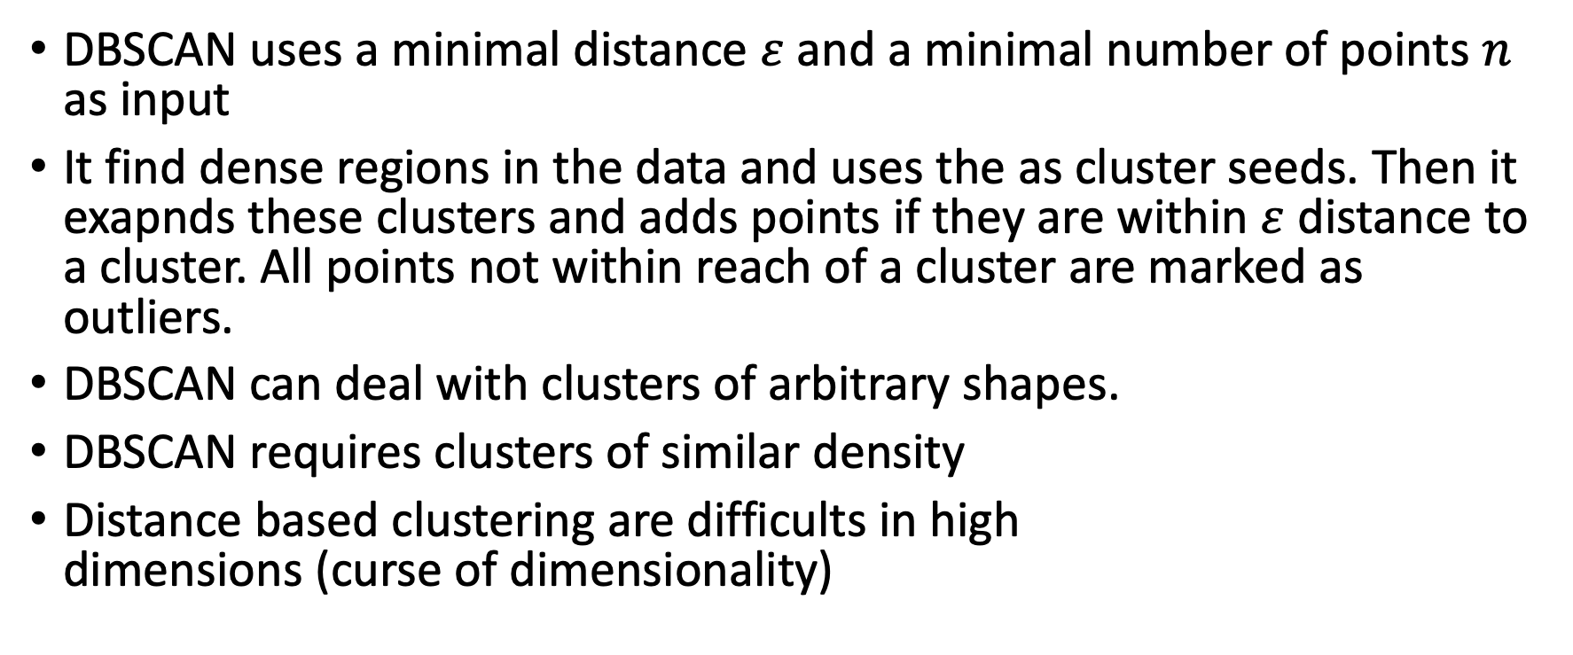
DBSCAN
DBSCAN uses a minimal distance $ε$ and a minimal number of points $n$ as input
It find dense regions in the data and uses the as cluster seeds. Then it exapnds these clusters and adds points if they are within $ε$ distance to a cluster. All points not within reach of a cluster are marked as outliers.
DBSCAN can deal with clusters of arbitrary shapes.
DBSCAN requires clusters of similar density
Distance based clustering are difficults in high dimensions (curse of dimensionality)
Ester et al., Proc KDD, 1996

Slide 19
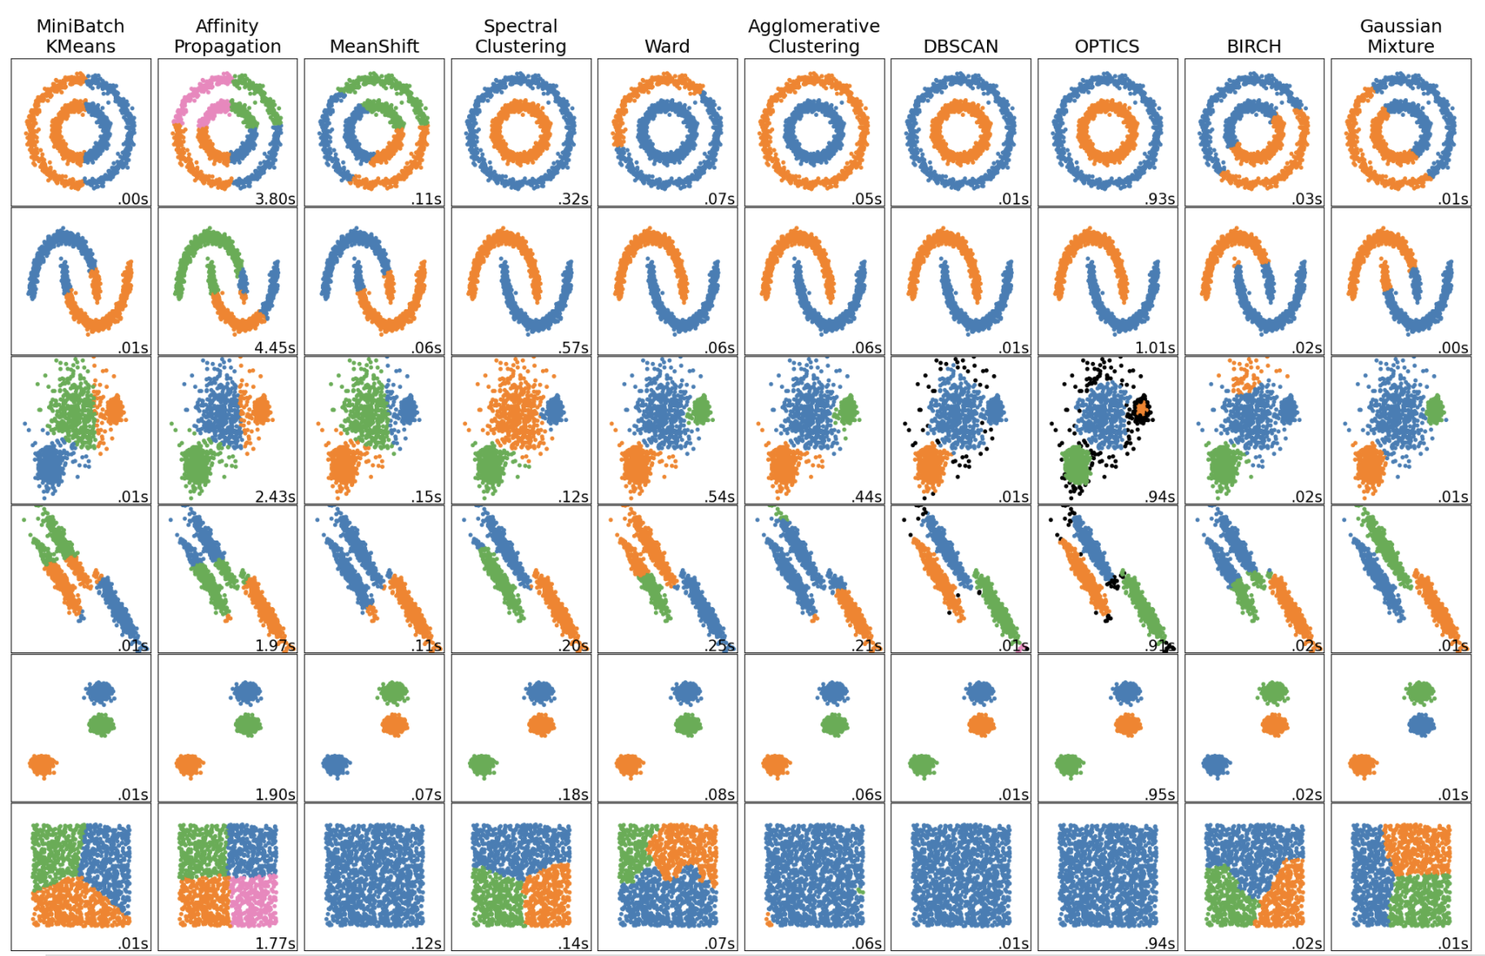
DBSCAN
sklearn docu

Slide 20
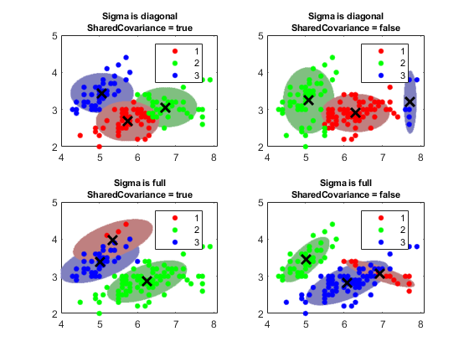
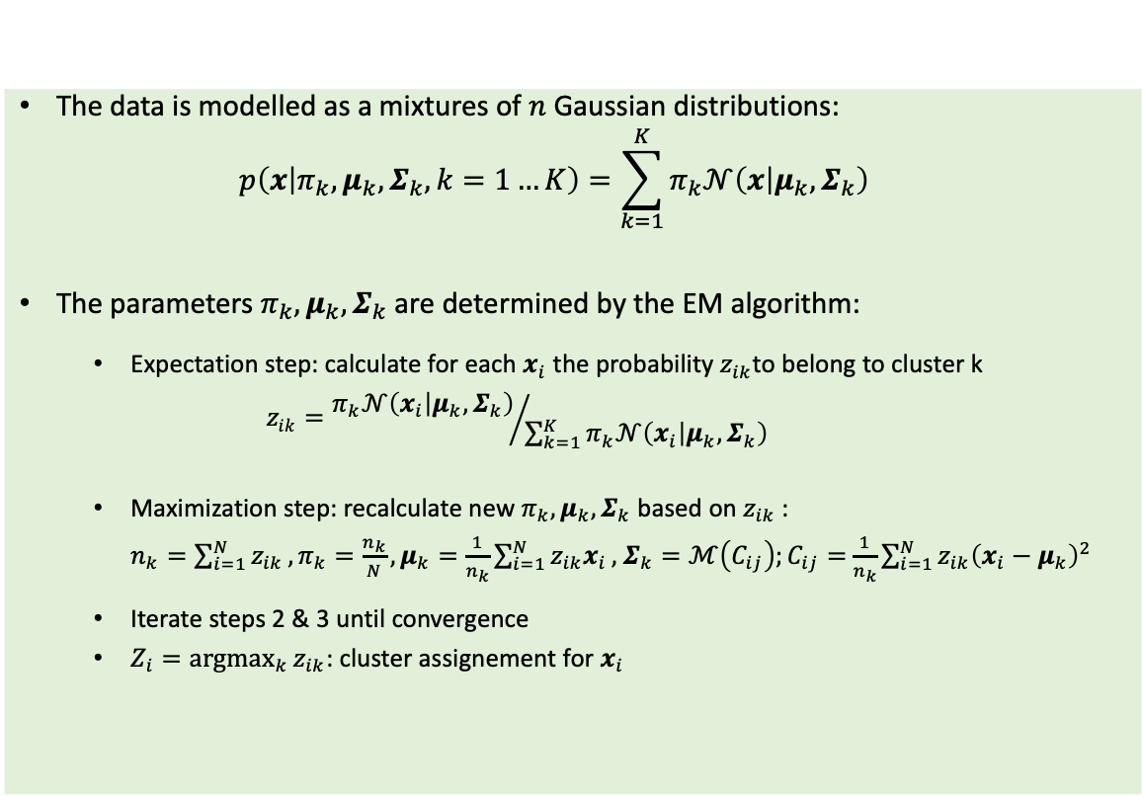
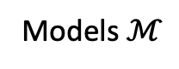
Gaussian Mixtures
Models $ℳ$
The data is modelled as a mixtures of $n$ Gaussian distributions: $p\left(x | π_{k},μ_{k},Σ_{k},k=1…K\right)=\sum_{k=1}^{K}{π_{k}𝒩\left(x | μ_{k},Σ_{k}\right)}$
The parameters $π_{k},μ_{k},Σ_{k}$ are determined by the EM algorithm:
Expectation step: calculate for each $x_{i}$ the probability $z_{ik}$to belong to cluster k $z_{ik}={π_{k}𝒩\left(x_{i} | μ_{k},Σ_{k}\right)}/{\sum_{k=1}^{K}{π_{k}𝒩\left(x_{i} | μ_{k},Σ_{k}\right)}}$
Maximization step: recalculate new $π_{k},μ_{k},Σ_{k}$ based on $z_{ik}$: ${n_{k}=\sum_{i=1}^{N}{z_{ik}}, π}_{k}=\frac{n_{k}}{N}, μ_{k}=\frac{1}{n_{k}}\sum_{i=1}^{N}{z_{ik}x_{i}},$ $Σ_{k}=ℳ\left(C_{ij}\right);C_{ij}=$ $\frac{1}{n_{k}}\sum_{i=1}^{N}{z_{ik}{\left(x_{i}−μ_{k}\right)}^{2}}$
Iterate steps 2 & 3 until convergence
$Z_{i}=\underset{k}{argmax}{z_{ik}}$: cluster assignement for $x_{i}$
Frailey & Raftery, The Computer Journal, 1998

